Slide 1
Scientific communication: the power of avoiding words
Danny Verboekend
Summerschool, University of São Paulo, February 4th 2016

Slide 2
Scientific communication: the power of avoiding words
“a picture speaks a thousand words”
Summerschool, University of São Paulo, February 4th 2016

Slide 3
Scientific communication: the power of avoiding words
or: “nobody likes to read”
Summerschool, University of São Paulo, February 4th 2016

Slide 4
Background
Born: Nieuwegein, Netherlands (1980s)
PhD: 2008-2010 ICIQ Spain
PhD: 2010-2012 ETH Zurich, Switzerland
Post-doc: 2012-2014: ETH Zurich, Switzerland
Post-doc: 2014-current: KU Leuven

Slide 5
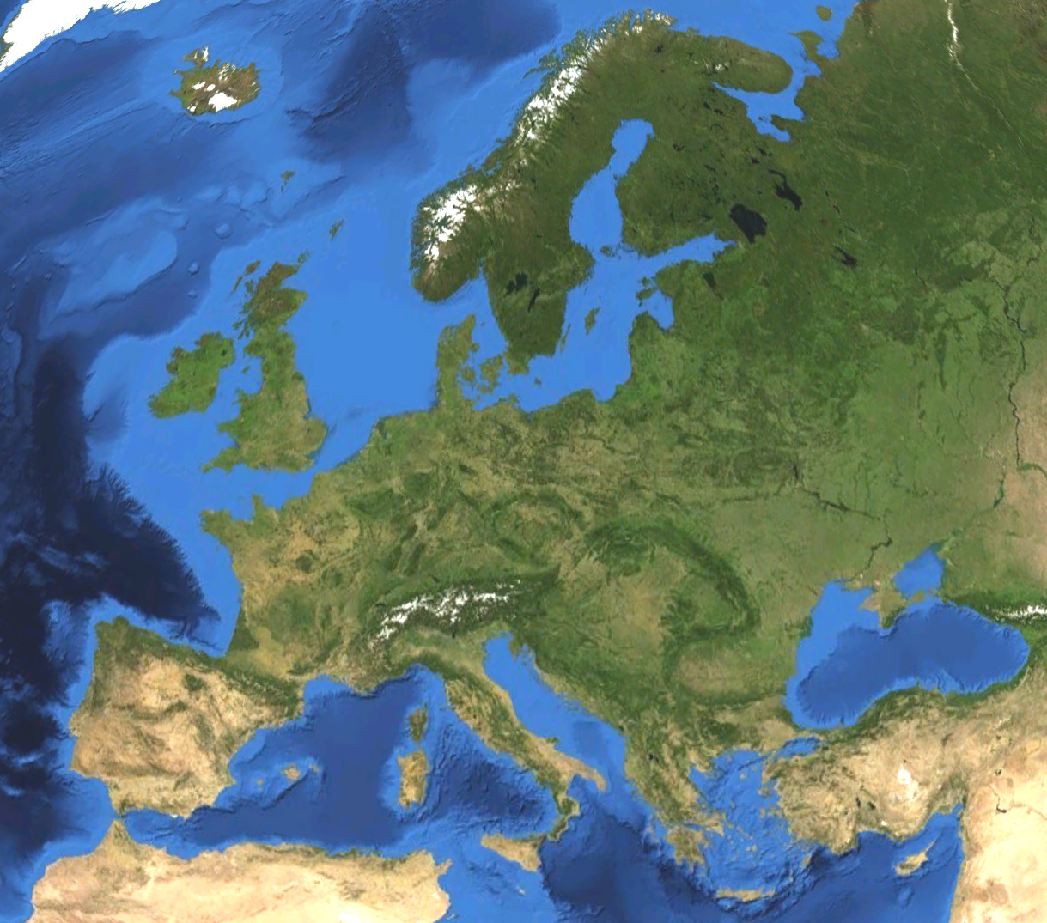
Background

Slide 6
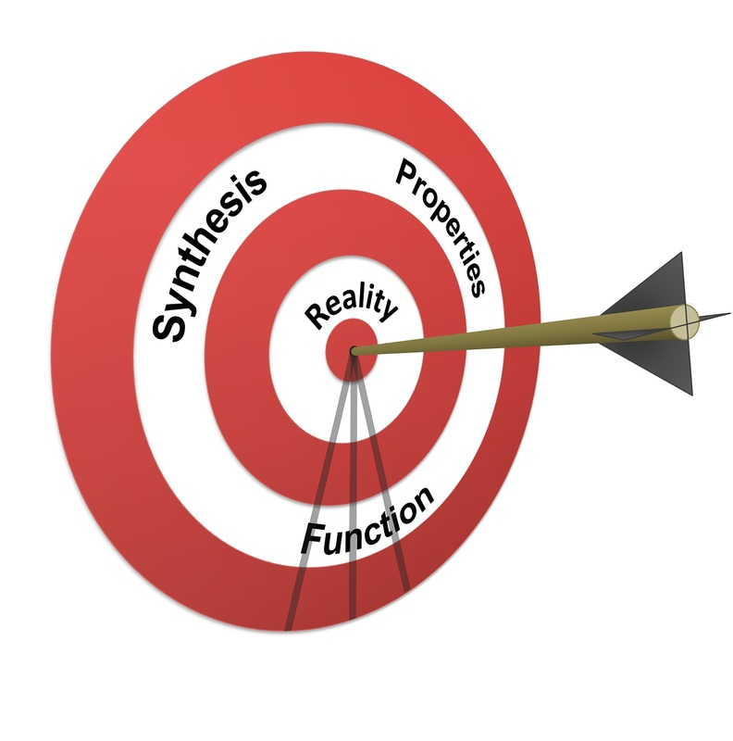
Scientific background
Heterogeneous catalysis
Adsorption
Zeolites
Catalyst design
Oil-derived feedstocks
Biomass-derived feedstocks

Slide 7
Feedstock
Conversion
Output

Slide 8
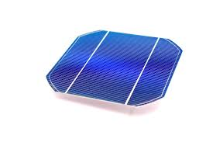
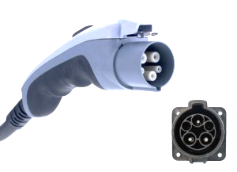
Feedstock
Conversion
Output

Slide 9
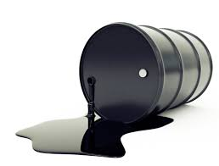
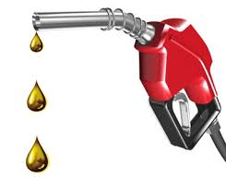
Feedstock
Conversion
Output

Slide 10
Feedstock
Conversion
Output

Slide 11
Feedstock
Conversion
Output

Slide 12
Feedstock
Conversion
Output
power
chemicals

Slide 13
Outline
Role of display items in science
Making figures: what (not) to do
Artwork in PowerPoint
Modifying pictures in PowerPoint
Animations in PowerPoint
Examples

Slide 14
1. Role of display items in Science
Texts and tables are hard to comprehend
Time is limited nowadays
Nobody reads a paper entirely
Statements have a lot more impact when supported by figures
Figures avoid unambiguity

Slide 15
1. Types of display items
Data figures
Most abundant
Flow charts
Schematic summaries
Feedstock
Output
Conversion

Slide 16
2. Figures in Science: General Tips
Figures First!
Structure your article/chapter based on the figures
Text acts in favour of the figures
Figures can act as a guide in writing
Do not duplicate!
Data presented in figures (or tables) does not need to be repeated in the text.
Plot till you drop!
Many trends become clear only after thorough digging
Critical on the ´state of the art´? Prove it in a figure!

Slide 17
2. Making figures: a science on itself
X-ray diffraction patterns of zeolites:
Crystalline nature of zeolites yields very sharps and intense peaks
Position first, intensity second
What is wrong here?
a.u.

Slide 18
2. Making figures: a science on itself
No need for 3D
Labels missing
Font sizes
Empty spaces
Scaling subtoptimal
Inconsistent units
Range 10-30 is most interesting
Arbitrary units (a.u.) do not need to be defined
a.u.

Slide 19
2. Making figures: a science on itself
No need for 3D
Labels missing
Font sizes
Empty spaces
Scaling subtoptimal
Inconsistent units
Range 10-30 is most interesting
Arbitrary units (a.u.) do not need to be defined
D
C
B
A

Slide 20
2. Making figures: a science on itself
Guilty as charged!

Slide 21
2. Making figures: a science on itself
Journal of Catalysis 2011
Advanced functional materials 2012
Mesoporous zeolites are better catalysts and
display enhance uptake in nitrogen adsorption
Scaling a powerful tool to highlight trends. N.B. Even if barely significant

Slide 22
3. Artwork in PowerPoint: basics
Why PowerPoint? Availability!
Are there better programs: probably many
Conceptual figures are of essential importance in science
These are the ones people remember!
Reponsibility not to be too ‘suggestive’

Slide 23
3. Artwork in PowerPoint: basics
Before you start: think, google, sketch: ‘brainstorm’
Customize PowerPoint:
Quick access toolbar
Themes and designs
Get to know Powerpoint:
Alt, ctlr, shift keys
Snap to grid
Zoom: only 400%
This is based on a tutorial on the website: www.sciencefarts.com

Slide 24
3. Artwork in PowerPoint: shapes
Shapes is a valuable option:
Union, Substract, Merge, Intersect
Aligning can be troublesome:
The align folder enables to align and distribute easily
Fix the Look aspect ratio:
Prevents your artwork from accidentilly deforming
Standard effects and smart art:
No need to reinvent the wheel explore the options
This is based on a tutorial on the website: www.sciencefarts.com

Slide 25
3. Artwork in PowerPoint: shapes
Edit points for trend lines and customized shapes
Use ctrl alt keys
Getting complicated? Use the selection pane to select the right object
Exporting your artwork:
Save as emf, open in paint, resize, and save as JPG

Slide 26
3. Artwork in PowerPoint: example
Dissolution of zeolite crystals occurs in 4 modes:
selective, non-connected
selective, connected
non-selective,
fragmentive
2.
4.
3.

Slide 27
3. Artwork in PowerPoint: example
During the lecture I enhance this sketch manually. You can have a try here! Use the tricks of the www.sciencefarts.com tips and tricks
selective, non-connected
selective, connected
non-selective,
fragmentive
1.
2.
3.
4.

Slide 28
4. Modifying pictures in PowerPoint
Contrast, Brightness, and Sharpen
Simple way to enhance pictures
Background removal and set transparent colour
Ideal for making making set ups look more ‘convincing’
Fill with image: ideal way to give a 3D look

Slide 29
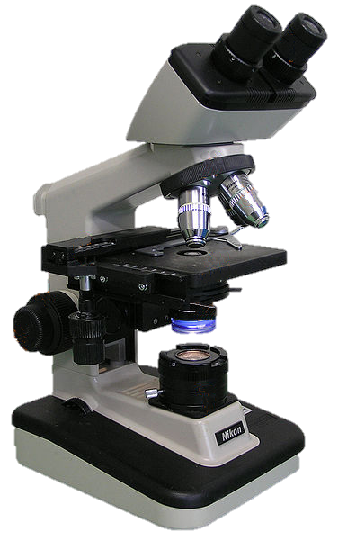
4. Modifying pictures in PowerPoint
Making routine pictures looks ´professional´

Slide 30
5. Animations in PowerPoint
Why?
For presentations and, moreover, for fun!
Why Powerpoint?: availability!

Slide 31
5. Animations in PowerPoint
Even more than with figures: think before!
Adjusting size is more difficult
Animation pane
Overview of animations

Slide 32
5. Animations in PowerPoint
Motion paths
Get things moving
Multiple animations, rotation, and timing
Make it realisitic
Smooth start and end
A standard setting

Slide 33
5. Animations in PowerPoint: example
Mesoporosity in zeolites leads to a smaller and more active particles
85 % green (active)
15% red (inactive)
50 % green
50% red

Slide 34
5. Animations in PowerPoint: example
Mesoporosity in zeolites leads to a smaller and more active particles
85 % green (active)
15% red (inactive)
50 % green
50% red
Initial dispersion

Slide 35
5. Animations in PowerPoint: example
Mesoporosity in zeolites leads to a smaller and more active particles
85 % green (active)
15% red (inactive)
50 % green
50% red
Initial dispersion
During Catalysis

Slide 36
6. Examples
Covers of scientific journals
Some made with powerpoint, others with the help of an artist (Marcel Reich, Switzerland)
Check for examples of animations on www.sciencefarts.com

Slide 37
Cover of Chemistry: a European Journal
2011, PhD -student
Full made in Powerpoint
3D rotation
Glow
Reflection
Shadows

Slide 38
Cover of Advanced functional materials
2012, sketched by PhD -student
Drawn and coloured by Marcel Reich
4 digital enhancements made in PowerPoint:
can you spot them?

Slide 39
Cover of Catalysis Science & technology
2011, sketched by PhD -student
Drawn and coloured by Marcel Reich
3 digital enhancements made in PowerPoint:
can you spot them?

Slide 40
Bonus tip:
During a presentation:
´w´, ´b´, and ´page# + enter´

Slide 41
Muito obrigado por sua atenção
Aproveitem o carnaval!

